Slide 1
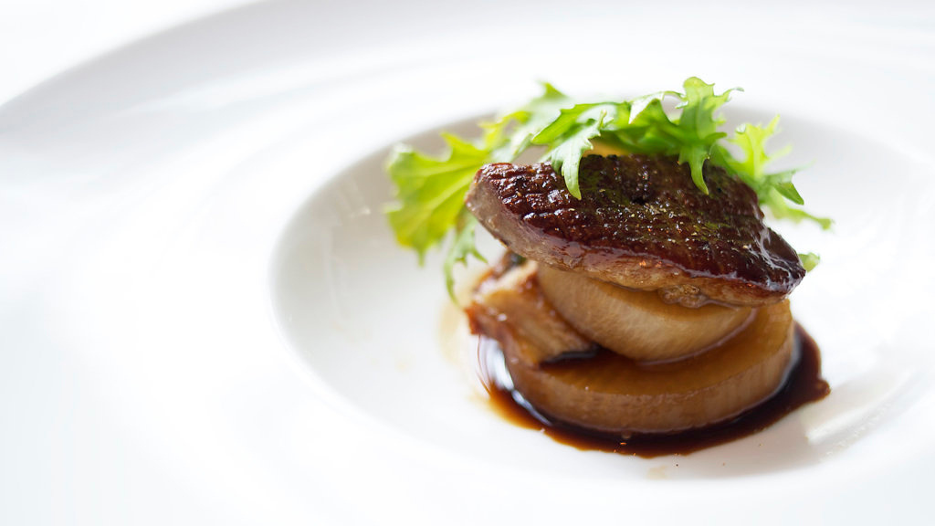
DESIGN INNOVATION PROJECT
RESHAREPEACE
A food sharing WebApp

Slide 2
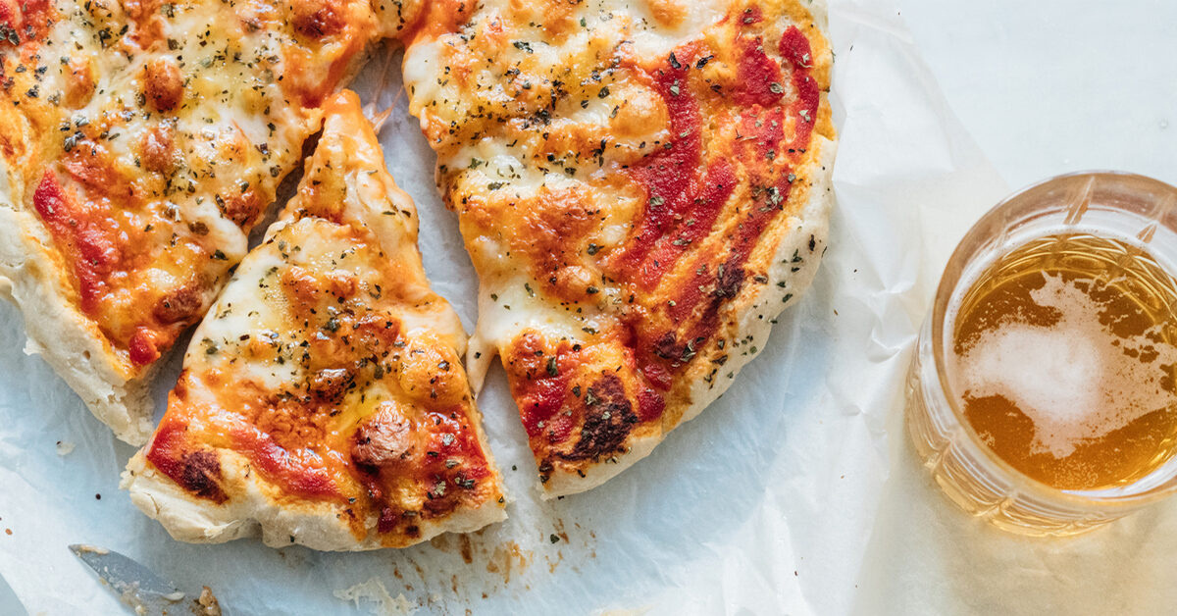
BACKGROUND
In the recent year, more people are picking up cooking as a hobby/new skill due to COVID and lockdown

Slide 3
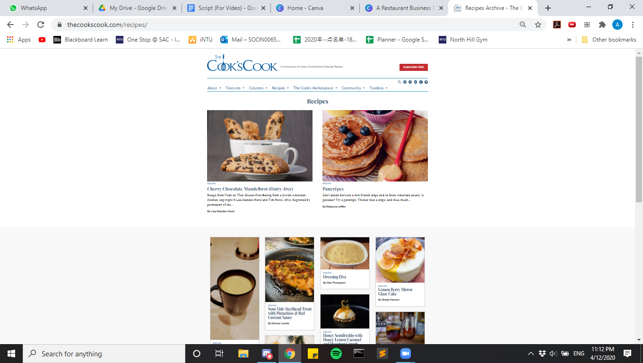
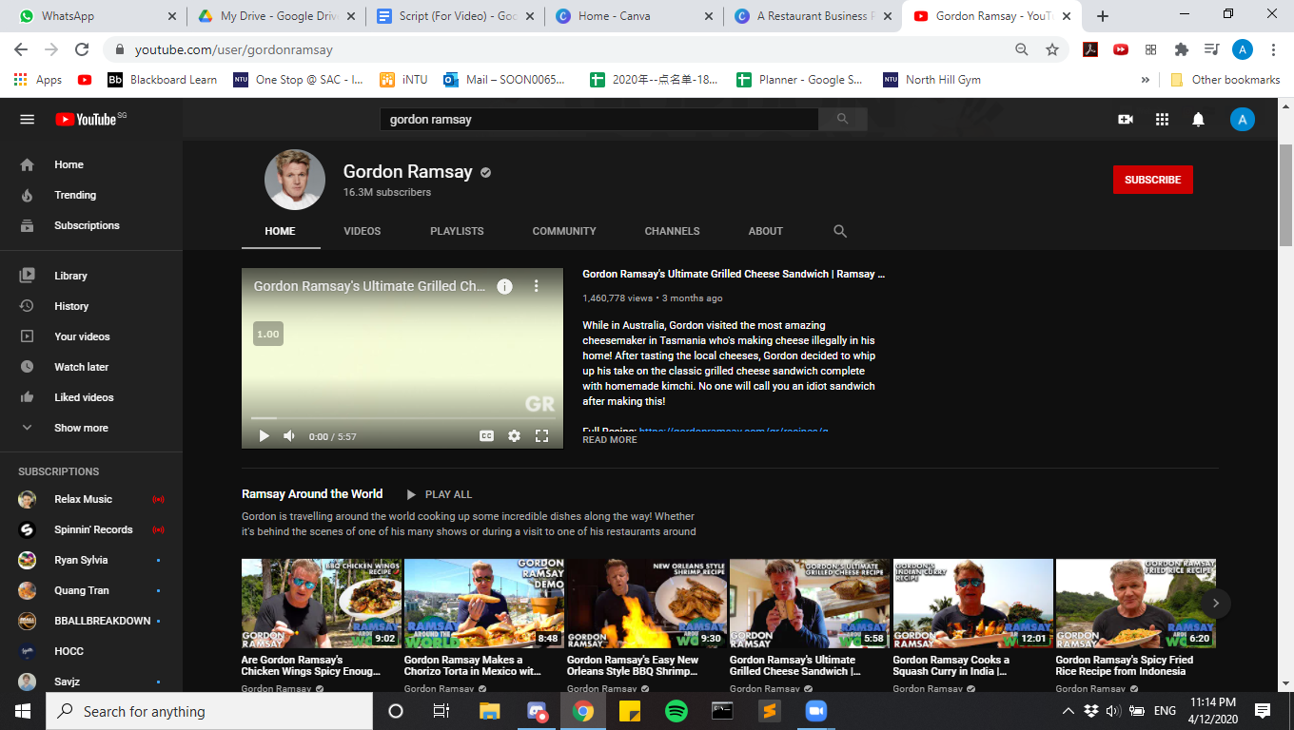
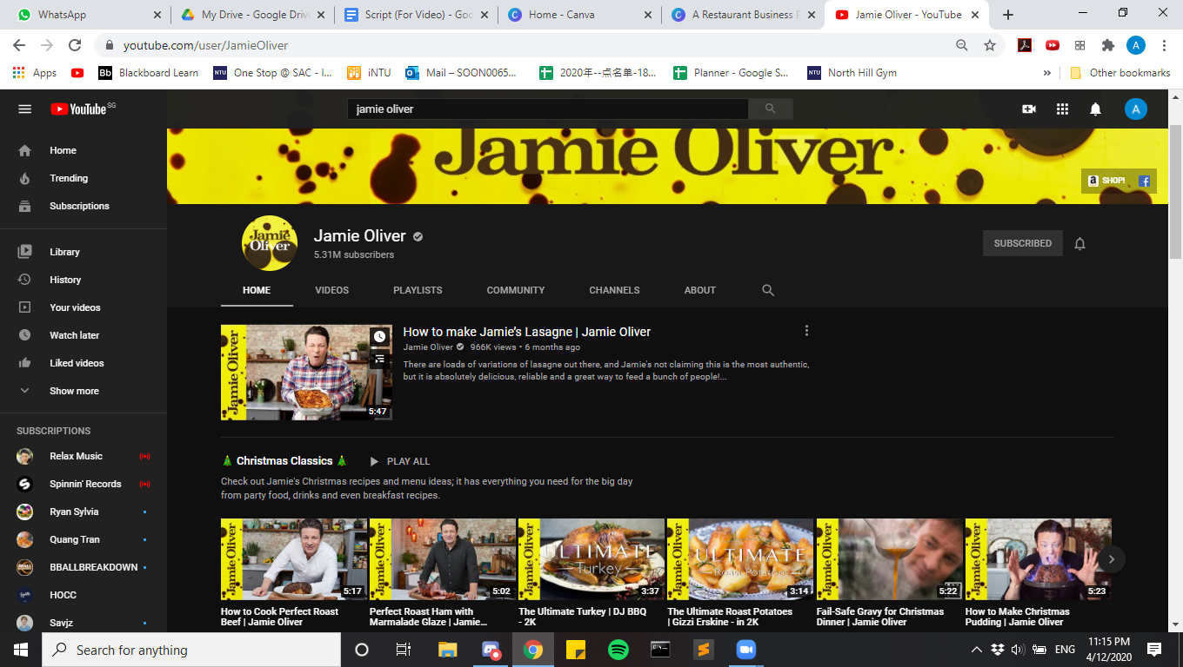

Slide 4
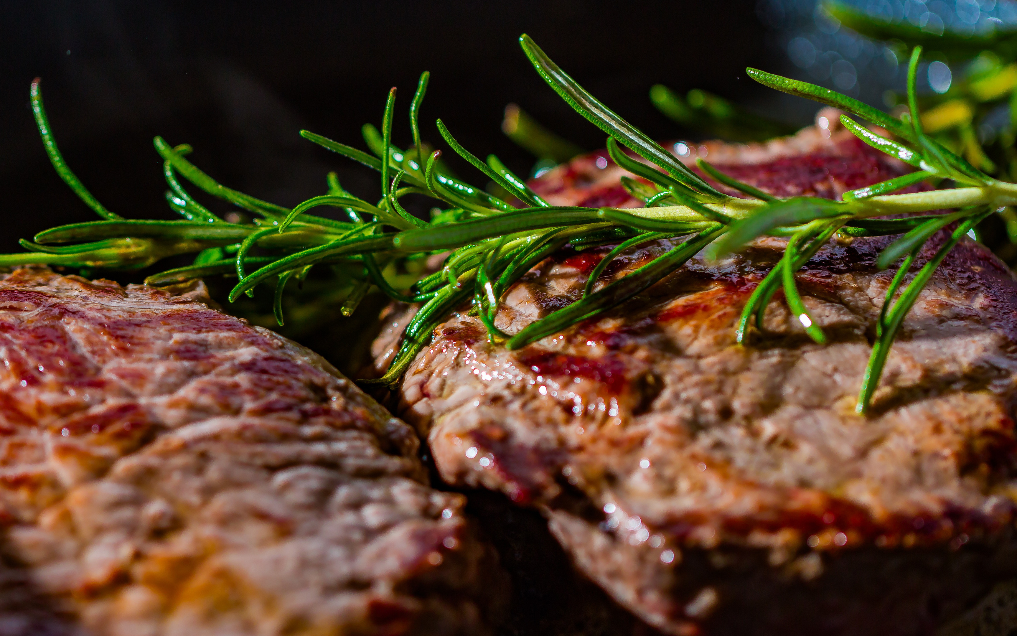
OUR PROJECT
RESHAREPEACE
ReSharePeace is a recipe sharing platform which incorporates elements of social media and live streaming functions.

Slide 5
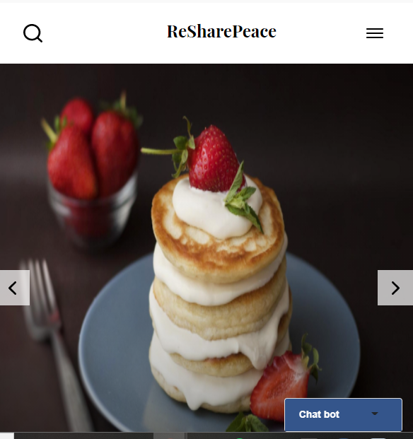
RESHAREPEACE
WHAT SETS US APART?
1) Real time video functions
2) Donation feature to support content creators

Slide 6
REAL TIME VIDEO FUNCTION
Node JS/WEB-RTC - providing real-time video communication
Multi-person support for conference room
Unique ID identifiers - rooms and individuals don't overlap
Real-time text chat - for efficient QnA
USING NODE.JS, WEB-RTC AND HEROKU CLOUD PLATFORM

Slide 7
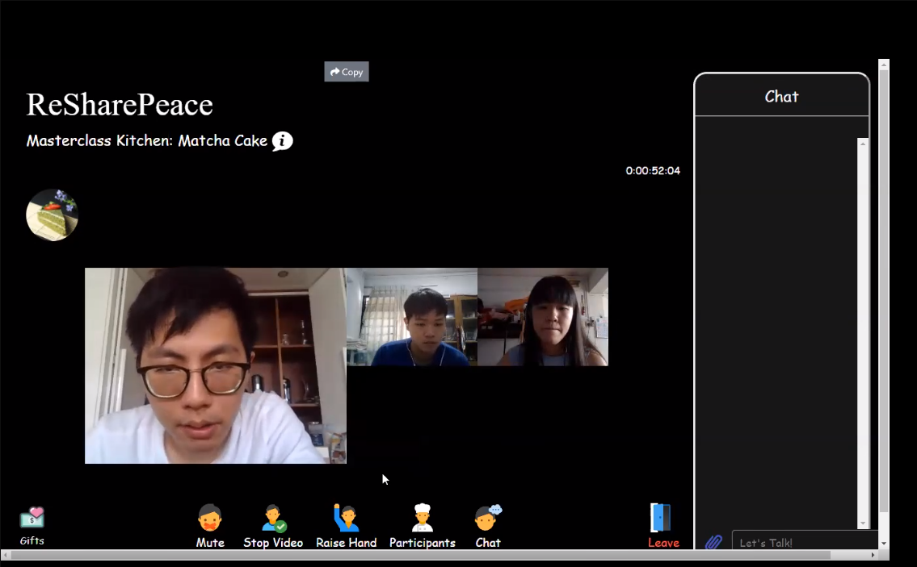
Real time video function

Slide 8
Video Communication:
Video learning is both interactive and safe
Small chatrooms-prevents overcrowding
Text chat provides alternatives for people who need to clarify with teachers
Icons are fun and differentiate us from current video platforms
FEATURE RATIONALE
WHY VIDEO COMMUNICATION?

Slide 9
Bootstrap toasts - alert notification for sending/receiving donations
JS & CSS Pop-up Modal - toggle window for donation system
Socket.io - retrieval of donation amount
DONATION & POINT SYSTEM
BASED ON TWITCH.TV

Slide 10
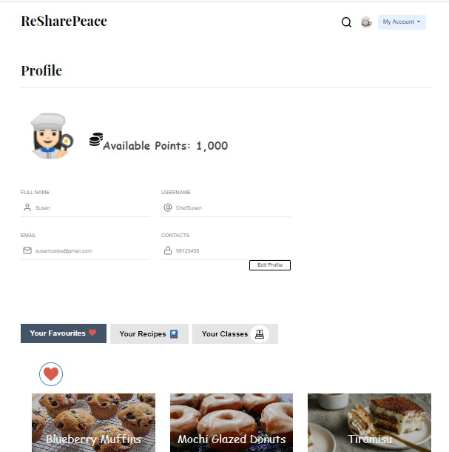
Point System:
Users earn points by watching or creating classes
They can also opt to buy points on our website
Points redeemed can be swapped for kitchenware on our site

Slide 11
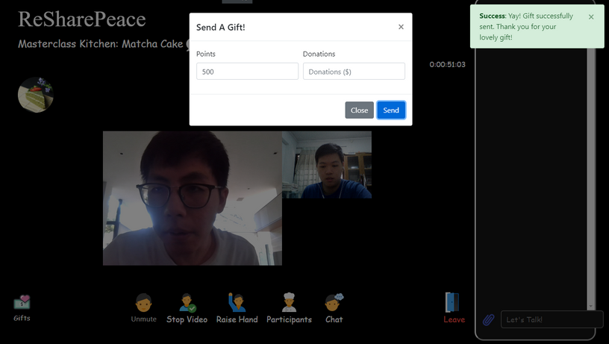
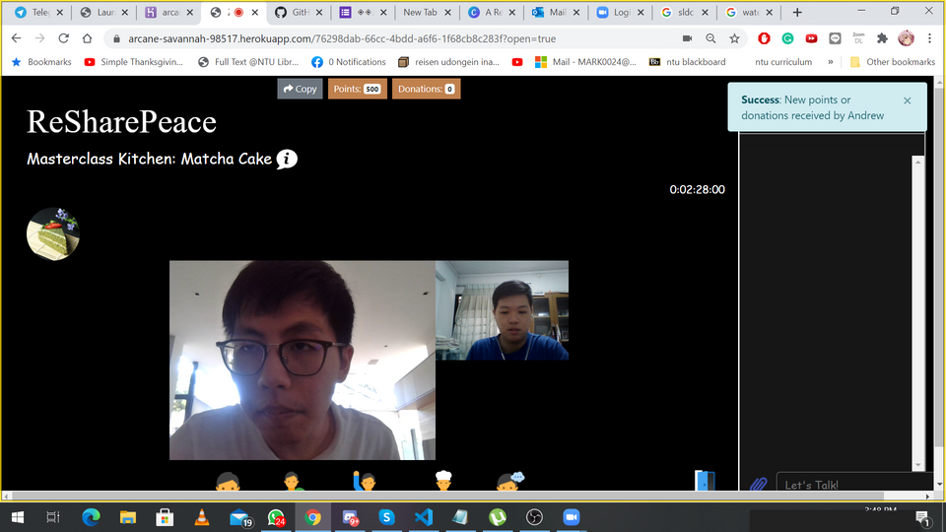
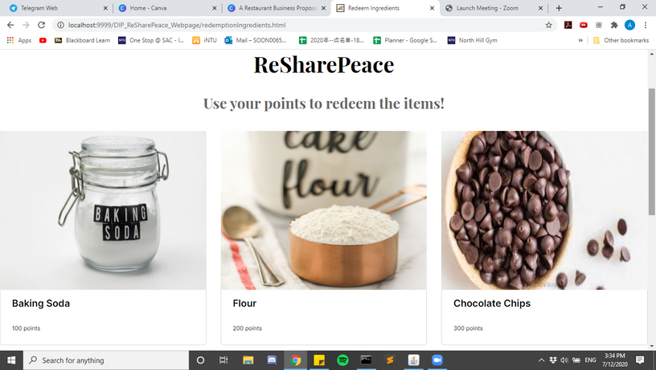
DONATION SYSTEM
VIEWER-END
HOST-END
REDEMPTION
Viewers have the option to donate in points or cash.
Hosts receives an alert for who donated and an update to their points/cash bar
Viewers and hosts can use accumulated points to redeem kitchenware on our site

Slide 12
Point/Donation System
Points incentivise both content creators and viewers to continue using the site
Donors have the option of either donating in points or actual cash
Potential income source for cookers motivates them to create more and better content
More content means an increase in user traffic - potential source of Ad-Revenue
FEATURE RATIONALE
WHY POINT/DONATION SYSTEM?

Slide 13
Point/Donation System
Points incentivise content creators and viewers
Option to donate in cash or points
Potential income source for cookers
Form of appreciation for content creators
FEATURE RATIONALE
WHY POINT/DONATION SYSTEM?

Slide 14
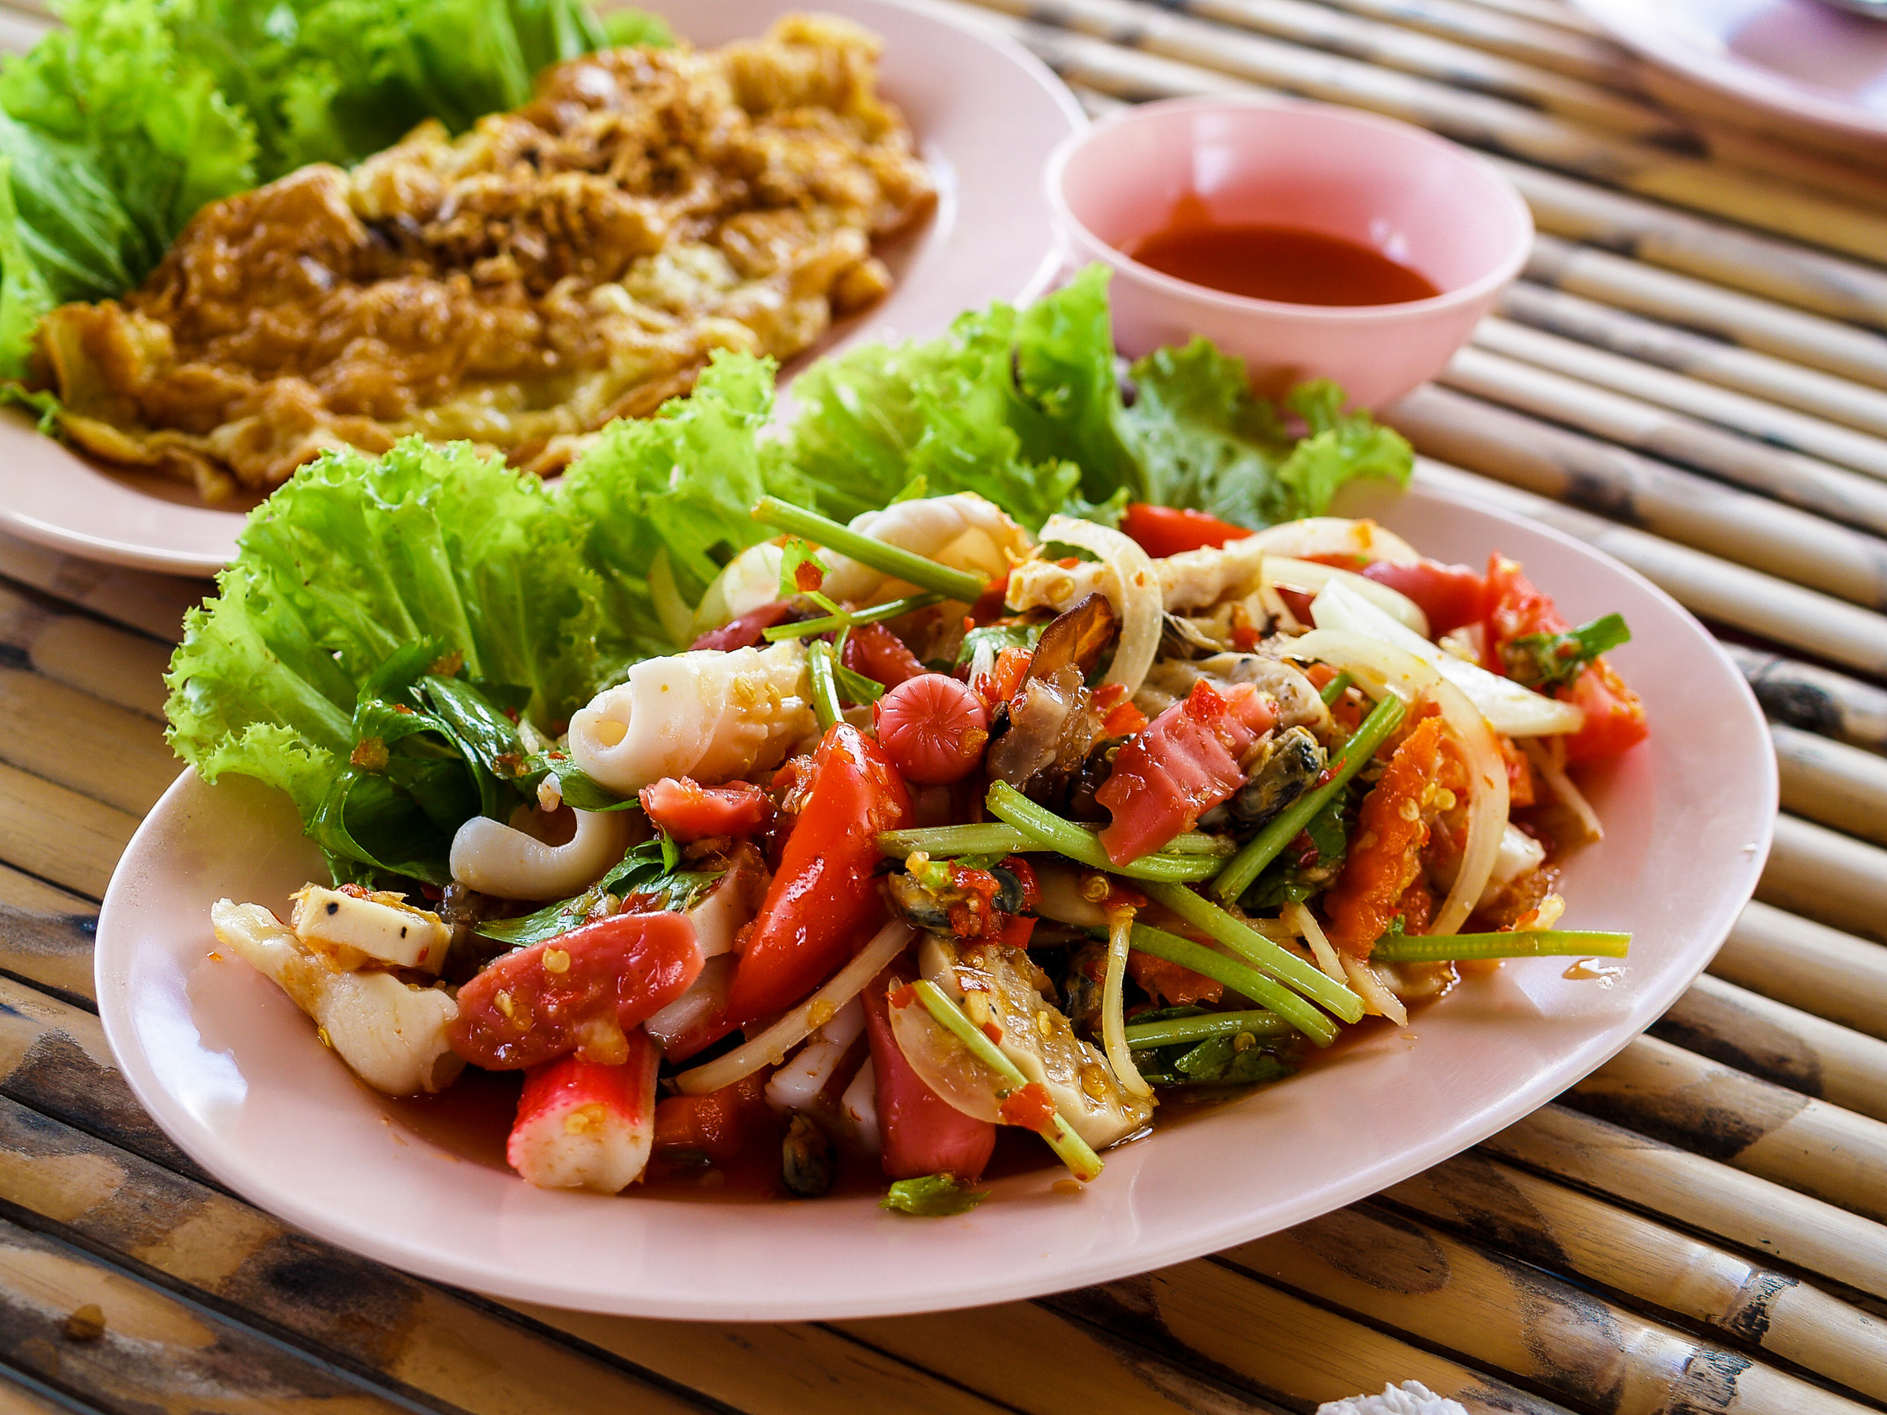
THANK YOU

